Slide 1
PRODUCTION
PLAN
https://youis11.github.io/Product-Plan-Research/

Slide 2
Area: Production Plan
Production plan is a document that needs to be delivered
● What is it?
● Why ?
● What it contains ?
● How is it useful ?
● How and when it should be updated ?
● To be considered…

Slide 3
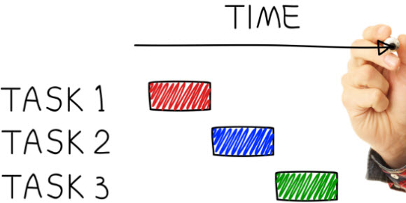
WHAT IS IT?
Collaborative document
Every member must be in it
Task list → TO-Dos
Preproduction document
Software like Smartsheet and Jira
https://www.mindjet.com/blog/wp-content/uploads/sites/6/2012/10/How-Social-Task-Management-Helps-Conquer-the-Big-32.jpg
Notes:
https://www.softwareadvice.com/project-management/agile-comparison/?deployment_id=&market_products_sort_order=&market_products_sortby=great_fit&more=true&price_ranges=1&stars=&segment_id=&platforms=&int_site_code=&size_id=

Slide 4

WHY?
What is the importance of this document?
  Selling the team and preproduction.
Who gives importance to the document?
  Investors and the team
More difficult comparing to other industries.
  Mantein the Project
  Assure the Product is going to sell
$10,000 per plan?
https://motto.za.net/wp-content/uploads/2018/12/5-Positive-Conflict-tips-You-Can-Learn-From-High-Performance-Teams.jpg
It’s not only about the game, it’s about the team.
Notes:
Very few titles ever make their costs back
Very few projects ever make it to the shelf
Research vs getting the analysis together

Slide 5

WHAT IT CONTAINS?
General Calendar of work
Risk and contingency list
Overall Gantt Chart
Meetings and postmortems
Average estimation deviation
+ Executive Summary
https://valleyrecovery.com/wp-content/uploads/2015/08/calendar-checkmark-sobor-monitoring-vrc.jpg

Slide 6
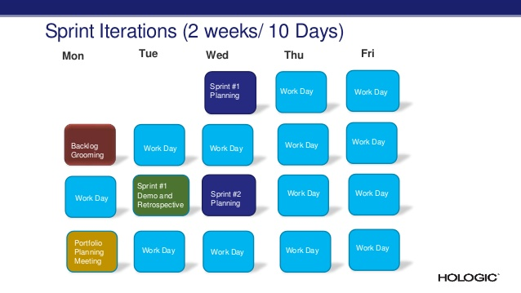
General Calendar of work
Include every sprint and milestones for each version.
Keep in mind the main features of the deliveries.
Who do you need? Estimation?
https://image.slidesharecdn.com/3933db9a-1a93-4e5b-ad2b-d07898cb0689-160602151318/95/qlikview-projects-in-agile-environment-8-638.jpg?cb=1464880617
Notes:
https://www.gamasutra.com/view/feature/3142/scrum_and_long_term_project_.php?print=1

Slide 7
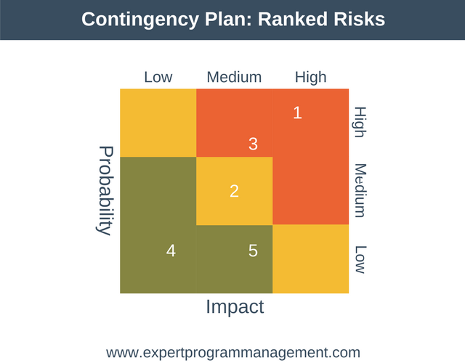
Risk and contingency list
Critical operations → Threats to those operations
Make a PLAN B
and C, D, E, F, G…
Evaluate PROBABILITY and IMPACT
Make up with a SOLUTION. Someone in charge?
Mantain it!
Try not to delay the plan in a future!
Break key tasks down to a greater level of detail to give better control!
Notes:
https://simplicable.com/new/risk-contingency
https://www.mindtools.com/pages/article/newLDR_51.htm
https://www.open.edu/openlearn/money-management/management/business-studies/preparing-project/content-section-7.3
https://expertprogrammanagement.com/2017/09/contingency-planning/

Slide 8
Overall Gantt Chart
Gantt charts are a great way to…
  improve productivity by making a project seem less daunting
  allowing for better timekeeping by pre-designating said time,
  allowing you to focus simply on doing what needs to be done.
Template Gantt Chart
Notes:
http://matthewgeorgethomasssp13.blogspot.com/2013/04/game-design-document-and-gantt-chart.html

Slide 9
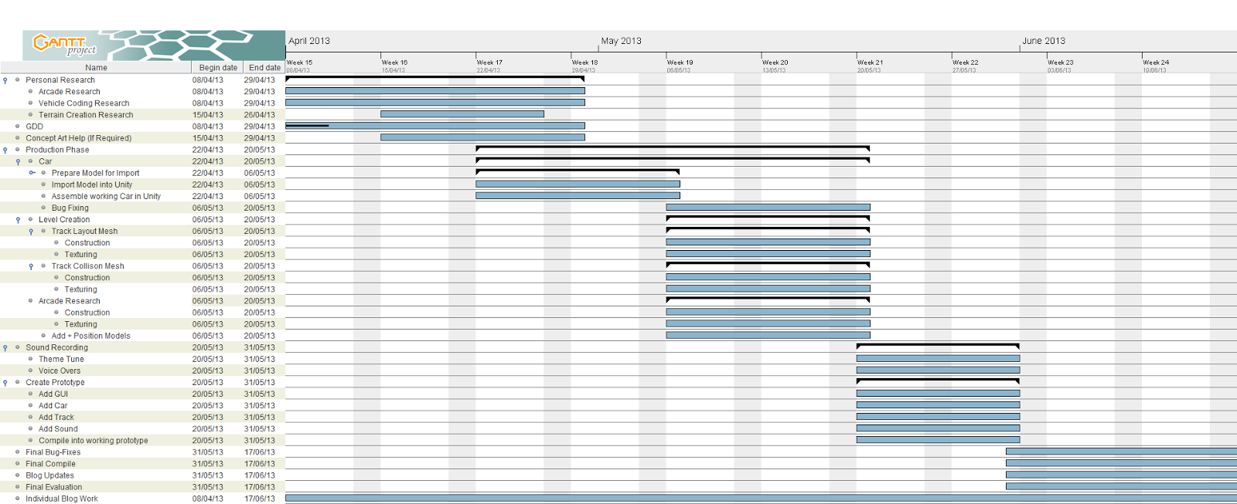
GANTT CHART EXAMPLE
http://4.bp.blogspot.com/-slwxmU0swX8/UarEGiNyA0I/AAAAAAAAA0I/X2wSxKj5T0M/s400/Gantt_Updated.png

Slide 10
average estimation deviation
It isn’t a fixed calendar, adjust to reality.
  Scrum adjusts the Sprint to it.
  Effectiveness doesn’t go with detail.
Schedules often don't predict many of the problems.
  Talk with the team, help each other.
Uses 3 estimates (optimistic (O), most likely (M), pessimistic (P))
Triangular distribution = (O + 4M + P) / 6
Notes:
www.gamasutra.com/view/feature/3142/scrum_and_long_term_Project
https://firebrand.training/uk/learn/pmp/course-material/project-time-management/estimate-activity-durations

Slide 11
postmortems
Make a postmortem at the end of each sprint.
  Stay positive and learning-focused
  Recap the sprint and the outcome
  Ask every member few questions.
  Give them the feedback!
1. Proud? What make it great or wrong?
2. Results we wanted and impactful?
3. Method worked well?
4. Method frustrating? Change?
5. Improvements?
6. Satisfying part?
Notes:
https://www.portent.com/blog/project-management/10-tips-for-a-successful-post-mortem.htm

Slide 12
Executive summary
Why is this important?
1-2 page summary.
Reiterate the most crucial points from each section.
Last paragraph: Funds Sought
Notes:
https://www.gamasutra.com/view/feature/131662/writing_a_business_plan_for_.php

Slide 13
TO BE CONSIDERED…
Kellee Santiago’s 10 steps
1. "We have to assess the realities of the time space continuum”.
3. Look at the calendar of events. You can sort of use submission to competitions as milestones, as an indie.
4. What are the biggest unknowns?
9. Re-evaluate the schedule regularly. You have to keep having conversations about your schedule.
10. Maintain a stable build. Vertical Slice sprints can help with that.
Notes:
https://www.gamasutra.com/view/news/228260/Kellee_Santiagos_10step_video_game_production_plan.php

Slide 14
SOURCES
https://www.softwareadvice.com/project-management/agile-comparison/?deployment_id=&market_products_sort_order=&market_products_sortby=great_fit&more=true&price_ranges=1&stars=&segment_id=&platforms=&int_site_code=&size_id
https://www.gamasutra.com/view/feature/3142/scrum_and_long_term_project_.php?print=1
https://simplicable.com/new/risk-contingency
https://www.mindtools.com/pages/article/newLDR_51.htm
https://www.open.edu/openlearn/money-management/management/business-studies/preparing-project/content-section-7.3
https://expertprogrammanagement.com/2017/09/contingency-planning/
http://matthewgeorgethomasssp13.blogspot.com/2013/04/game-design-document-and-gantt-chart.html
www.gamasutra.com/view/feature/3142/scrum_and_long_term_Project
https://firebrand.training/uk/learn/pmp/course-material/project-time-management/estimate-activity-durations
https://www.portent.com/blog/project-management/10-tips-for-a-successful-post-mortem.htm
https://www.gamasutra.com/view/feature/131662/writing_a_business_plan_for_.php
https://www.gamasutra.com/view/news/228260/Kellee_Santiagos_10step_video_game_production_plan.php

Slide 15


CONTACT
Lluís Moreu Farran
lluis.moreu@gmail.com
lluismf3

Slide 16
“I am <link to your linkedIn>(NAME LASTNAME), student of the
<https://www.citm.upc.edu/ing/estudis/graus-videojocs/>(Bachelor’s Degree in
Video Games by UPC at CITM). This content is generated for the second year’s
subject Project 2, under supervision of lecturer
<https://es.linkedin.com/in/ricardpillosu>(Ricard Pillosu).”

